Slide 1

IoT Gateway Solutions
Jack Tsai
12 Jan., 2015

Slide 2
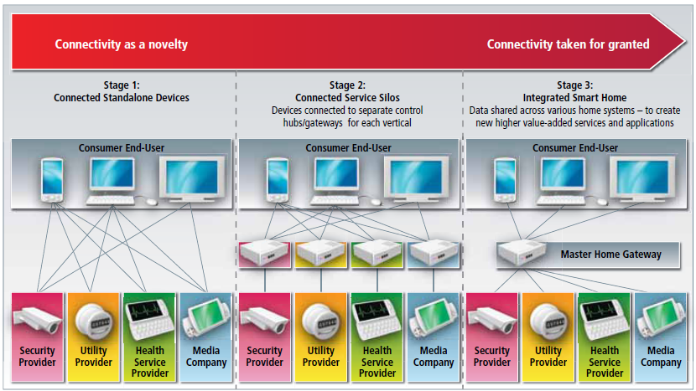
Smart Home Services Evolution Scenario

Slide 3
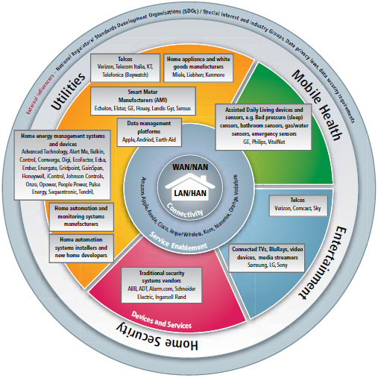
Smart Home Ecosystem

Slide 4
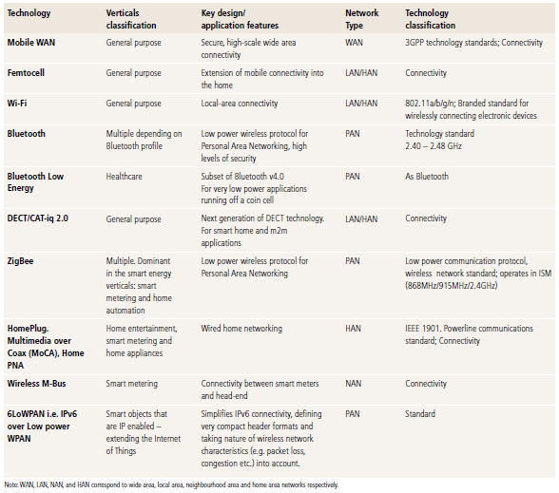
Wide- and Home-Area Networking Standards

Slide 5
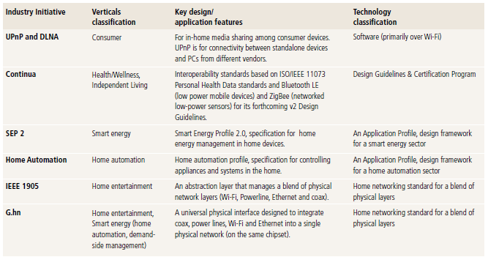
Interoperability Developments and Standards

Slide 6
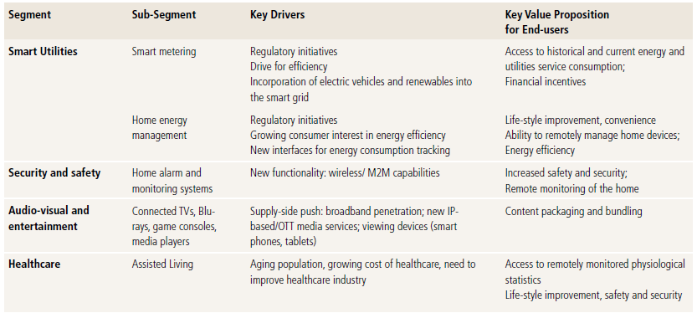
Smart Home: Major Segments, Key Drivers and Value Proposition

Slide 7
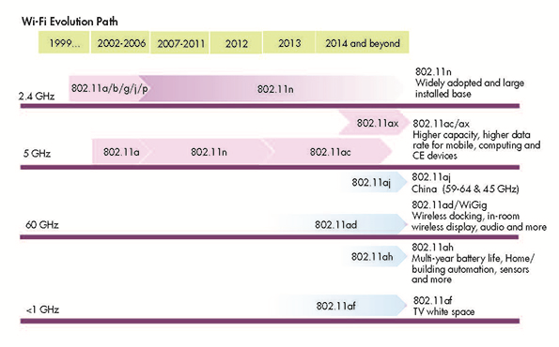

Slide 8
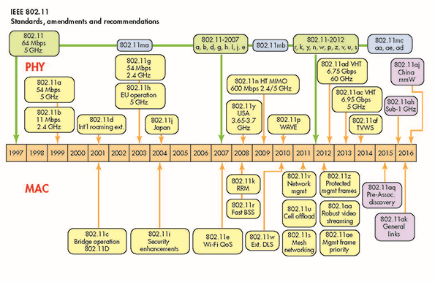

Slide 9
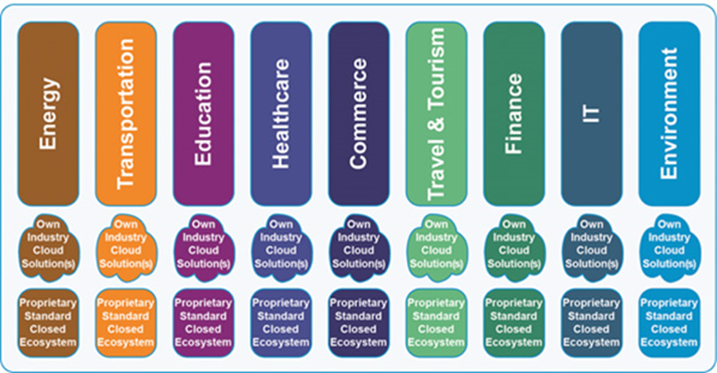
Applications as vertical “silos”

Slide 10
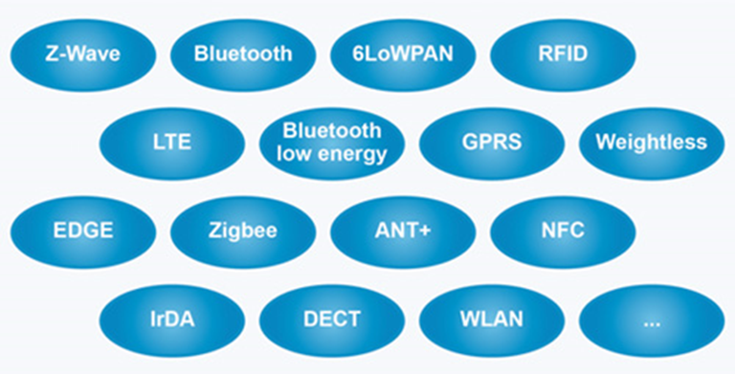
Wireless technologies in the IoT space

Slide 11
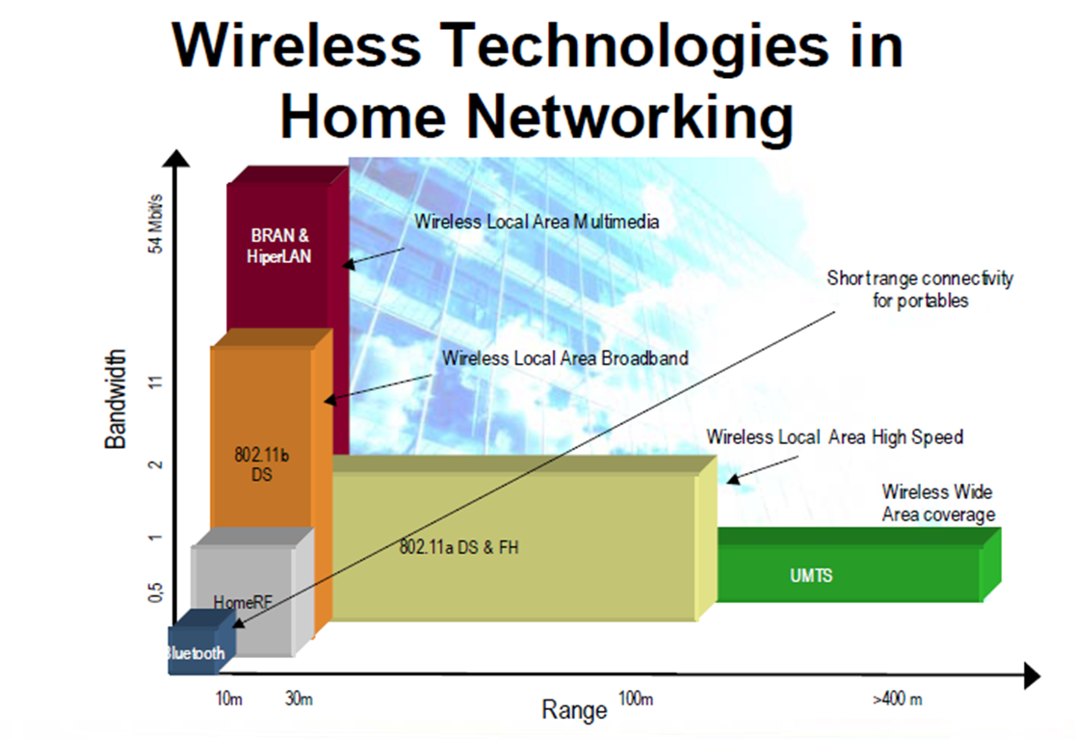

Slide 12
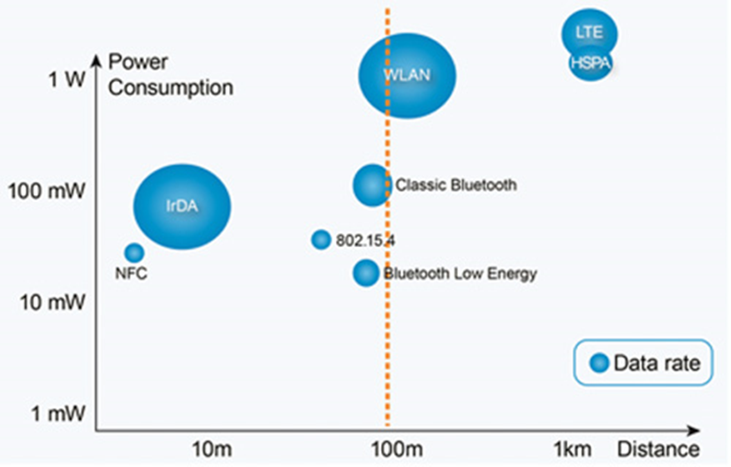
Short-range technologies with power consumptions, distances and data rates

Slide 13
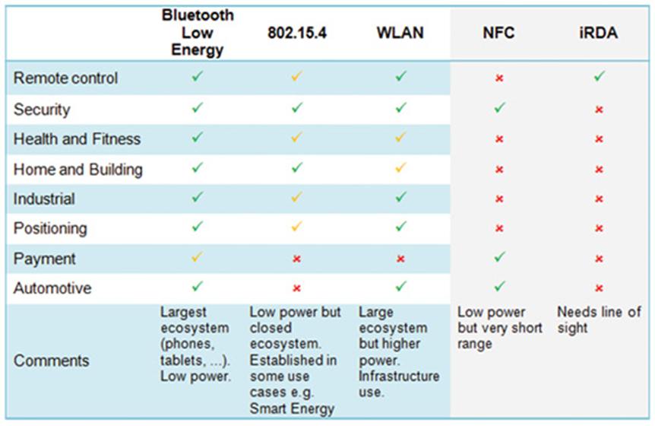
Technologies and Verticals

Slide 14
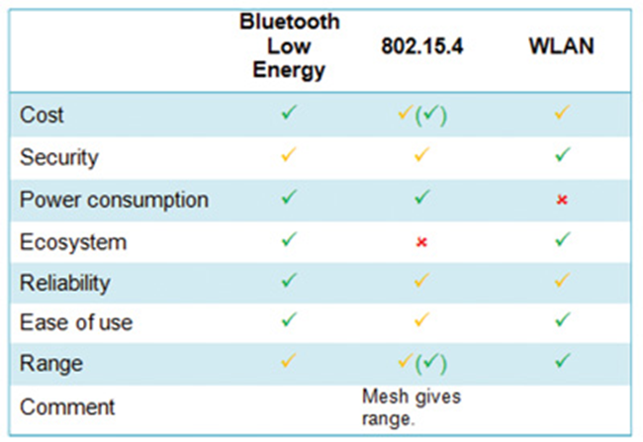
Comparison of wireless technologies and their usefulness in IoT

Slide 15
Comparison of wireless technologies and their usefulness in IoT
•All three technologies have built-in link layer authentication and encryption which sometimes needs to be completed with end-to-end security from the sensor to the Web application.
•Some IoT use cases may be fully behind an enterprise firewall (e.g., a use case inside a factory where the IoT Internet Service runs on a local server). There are also IoT systems operating on a wide-area network, but acting as local networks by the use of VPN tunnels or similar security mechanisms.
•Correctly used, Bluetooth low energy has the potential for less power consumption than 802.15.4 (less overhead).
•The lack of native support for 802.15.4 in the ecosystem’s important mobile devices (smartphones, tablets, laptops, etc.) is a problem, especially for mobile or temporarily mobile use cases.
•The ecosystem with phones, tablets, laptops and phone accessories will drive down the cost for Bluetooth low energy.
•802.15.4 has a main advantage in its range since many 802.15.4 based technologies (e.g. ZigBee) support mesh whereby coverage can be extended by using routers.
•Bluetooth low energy is very reliable with its support for Adaptive Frequency Hopping (AFH) and other features inherited from Classic Bluetooth.
•WLAN, also commonly referred to as Wi-Fi, can be used in devices with less demands on low power consumption and as a wireless backbone in combination with other technologies (more on this later).

Slide 16
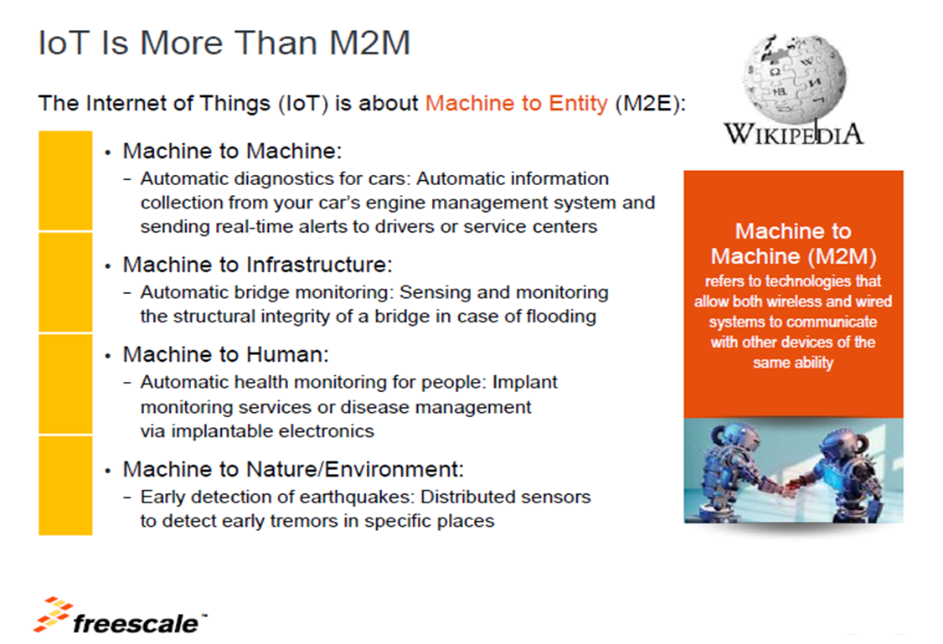

Slide 17
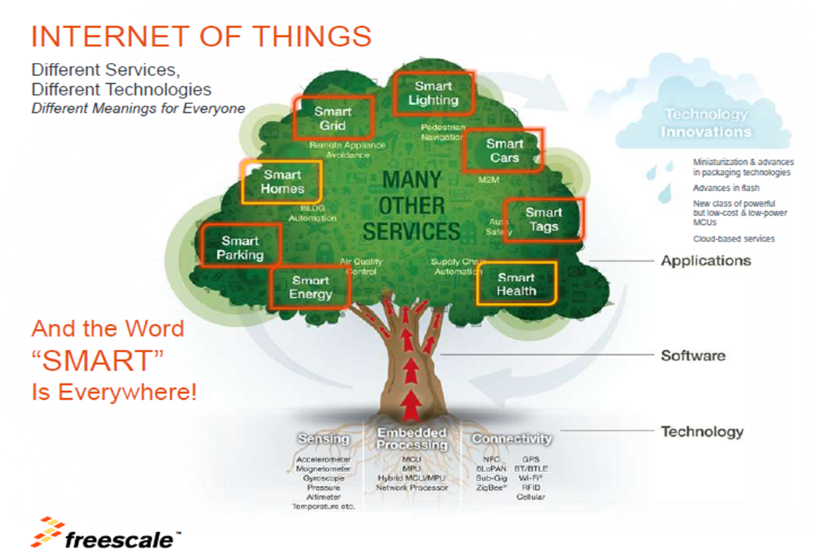

Slide 18
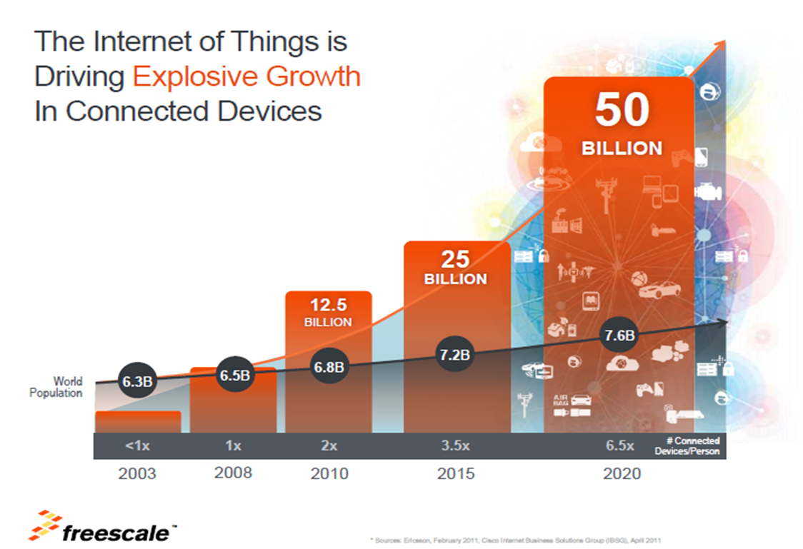

Slide 19
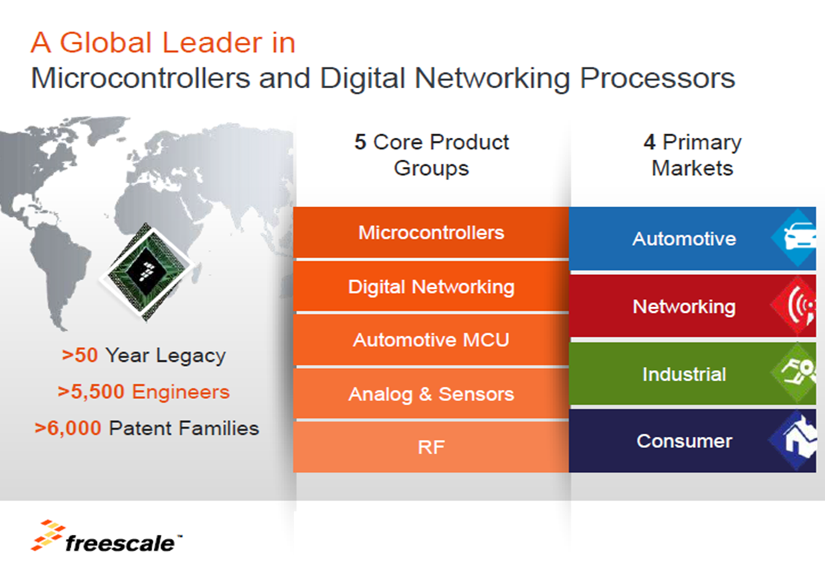

Slide 20
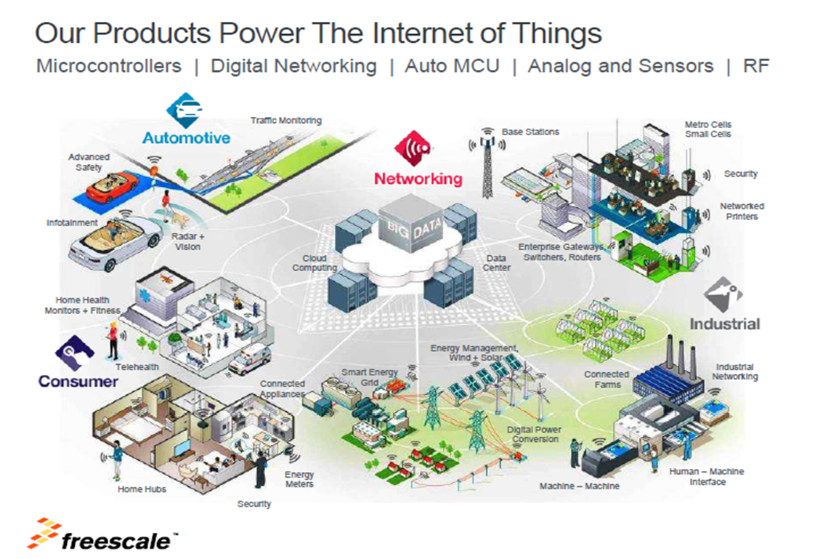

Slide 21
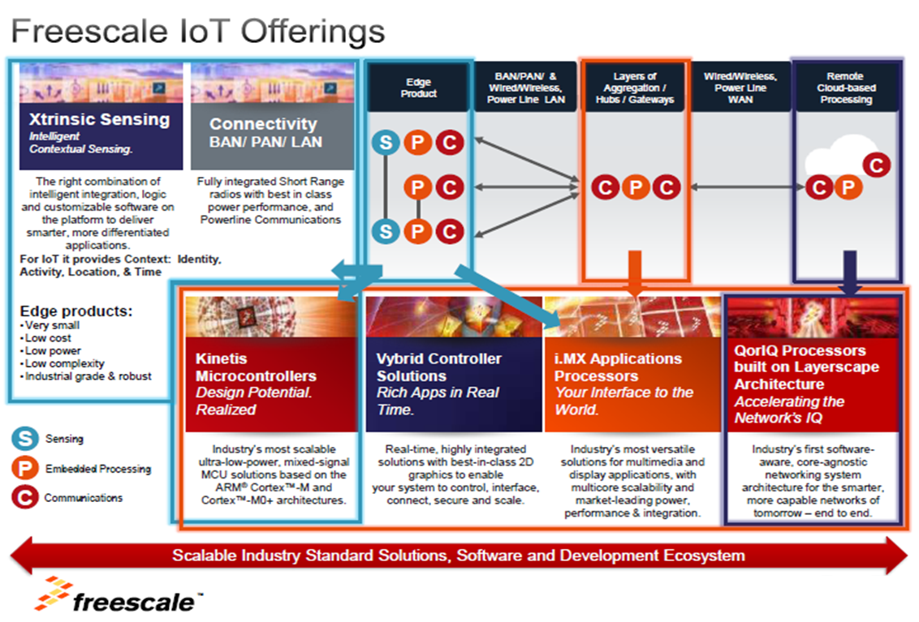

Slide 22
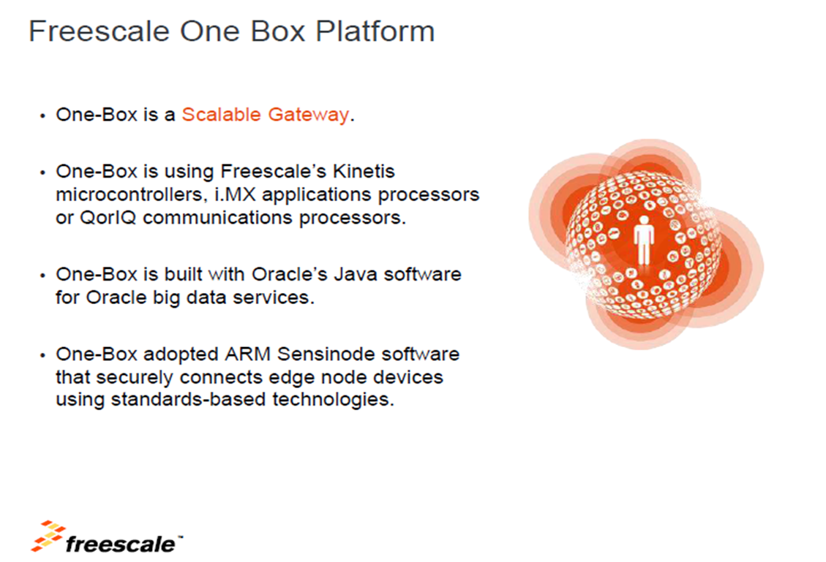

Slide 23
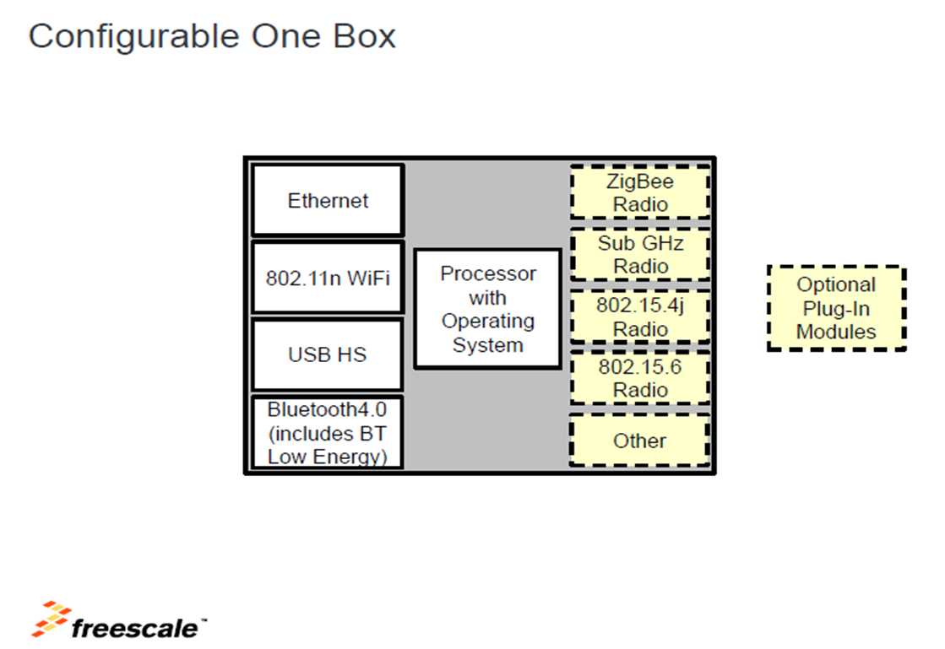

Slide 24
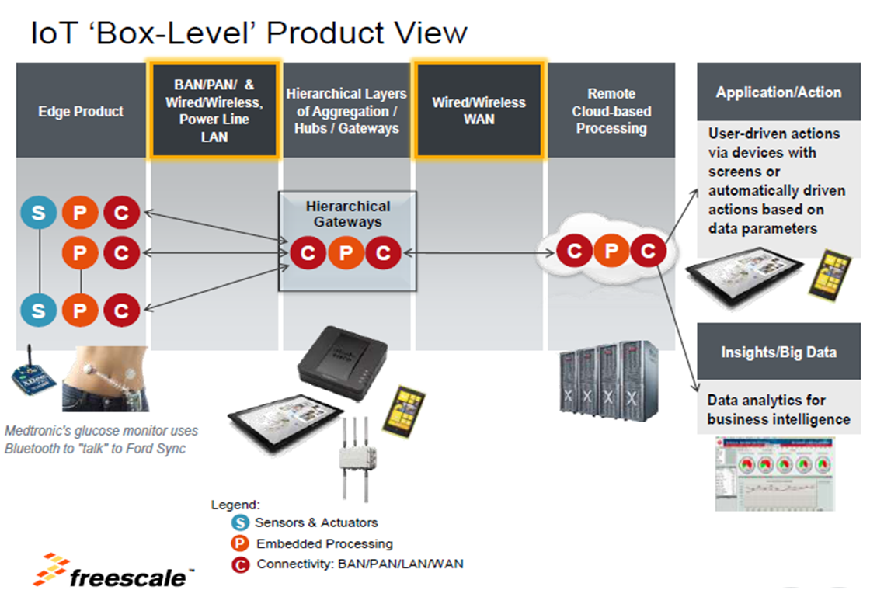

Slide 25
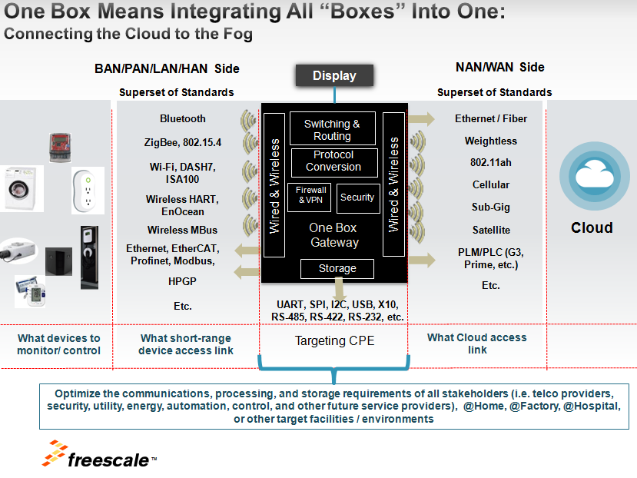

Slide 26
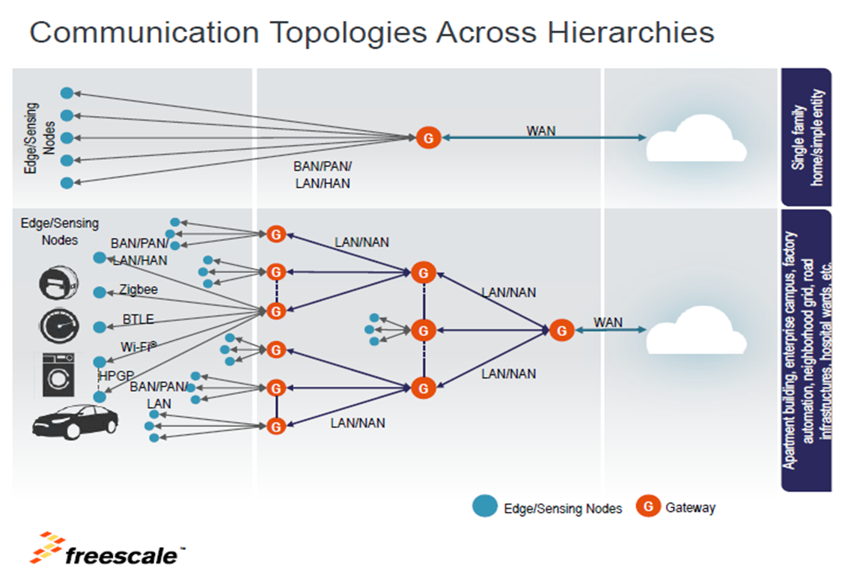

Slide 27
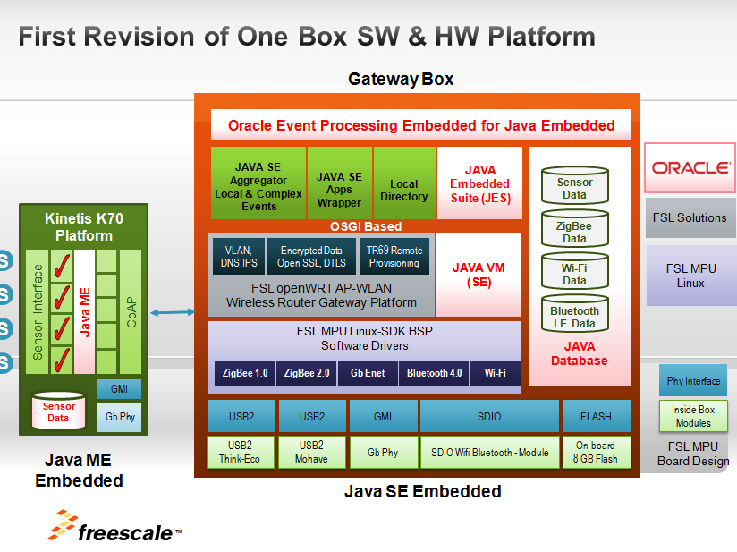

Slide 28
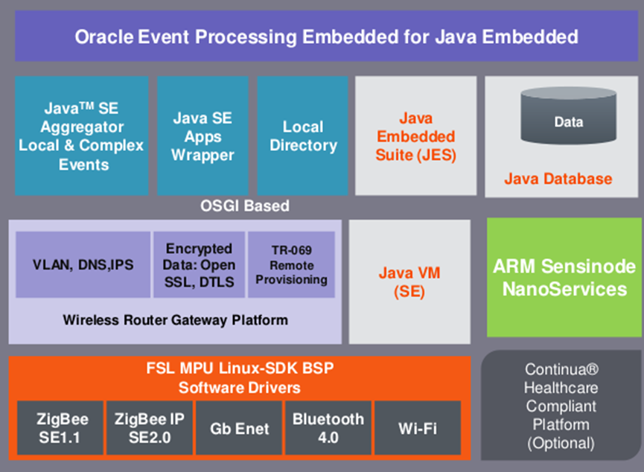
Oracle Event Processing (OEP) system

Slide 29
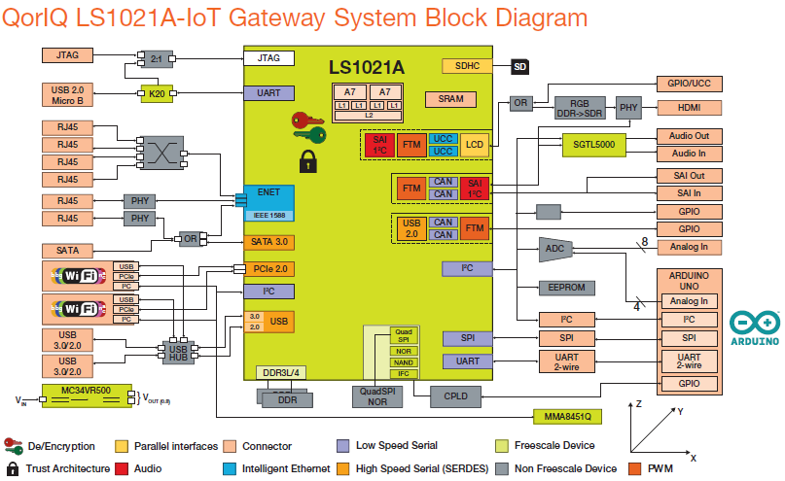

Slide 30
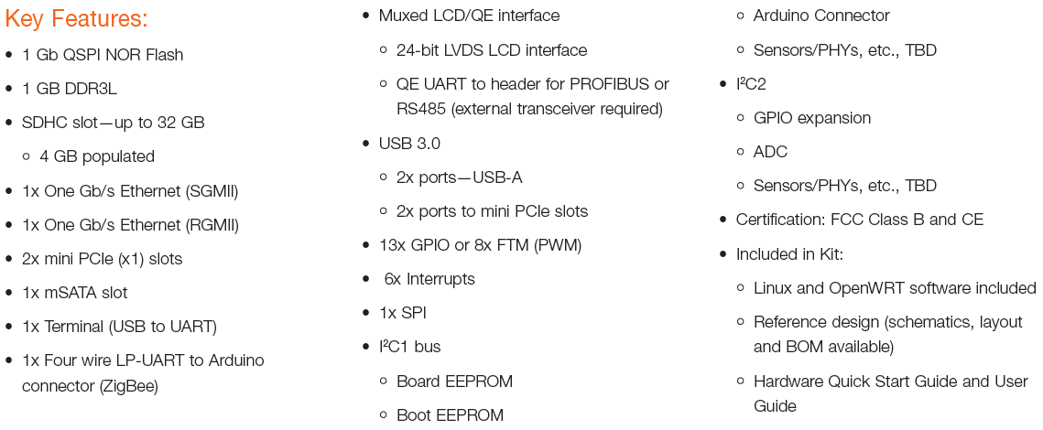
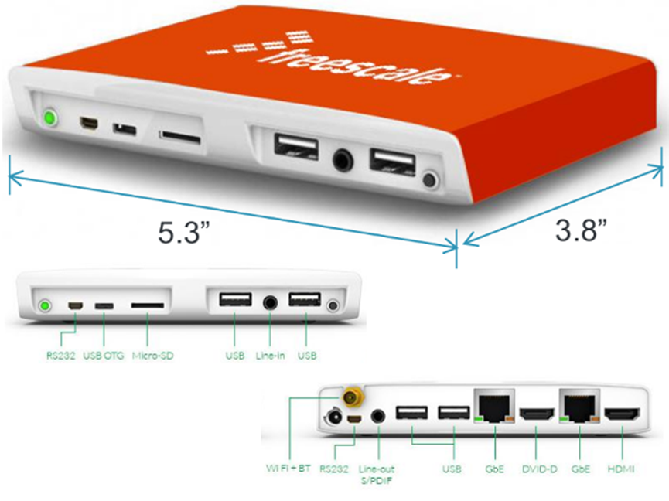

Slide 31
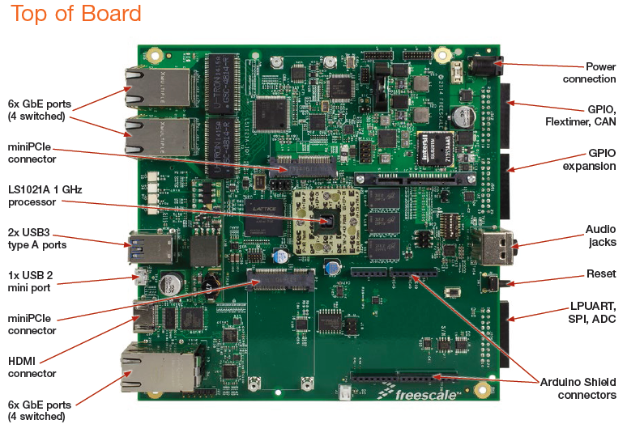

Slide 32
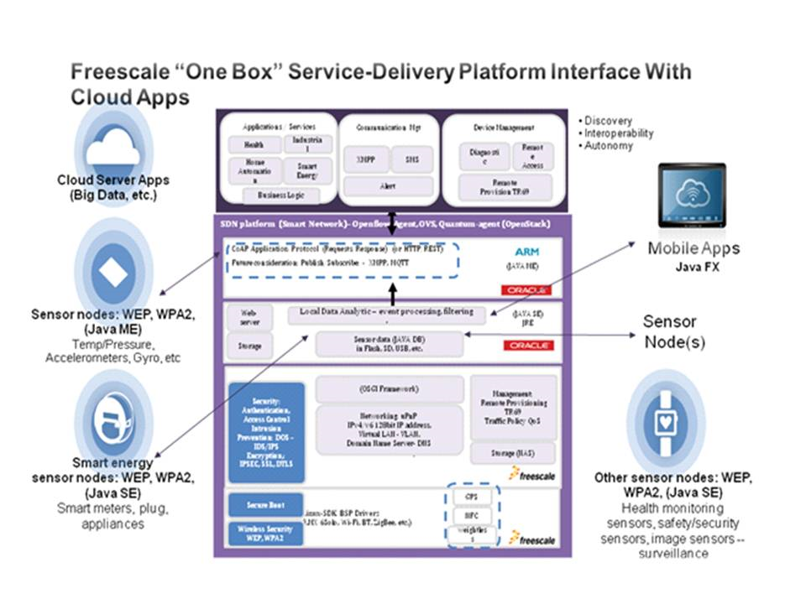

Slide 33
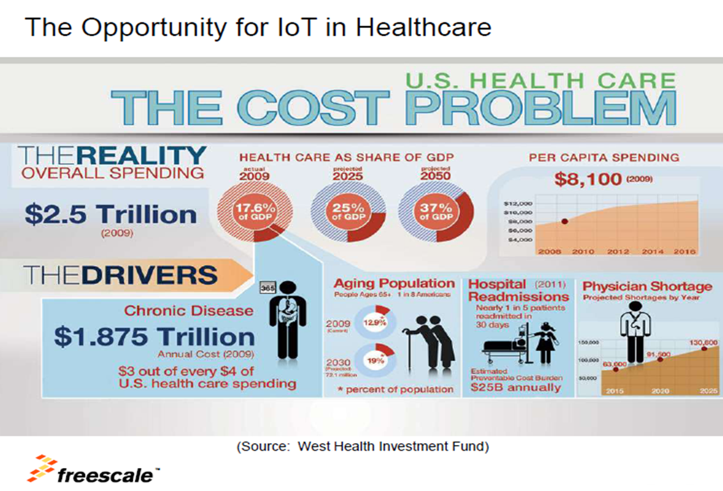

Slide 34
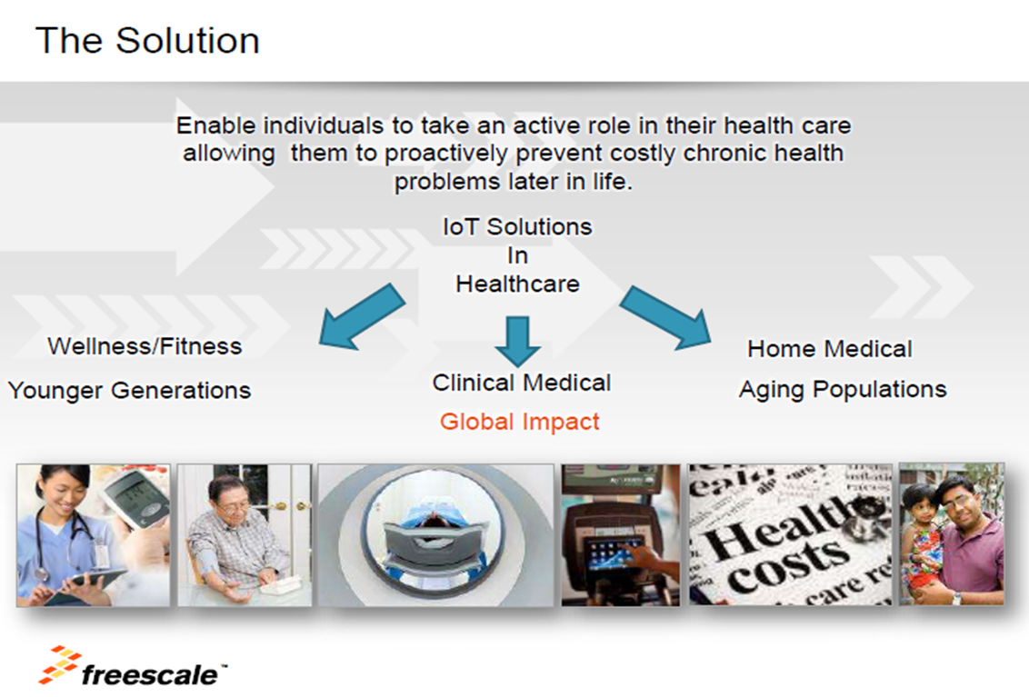

Slide 35
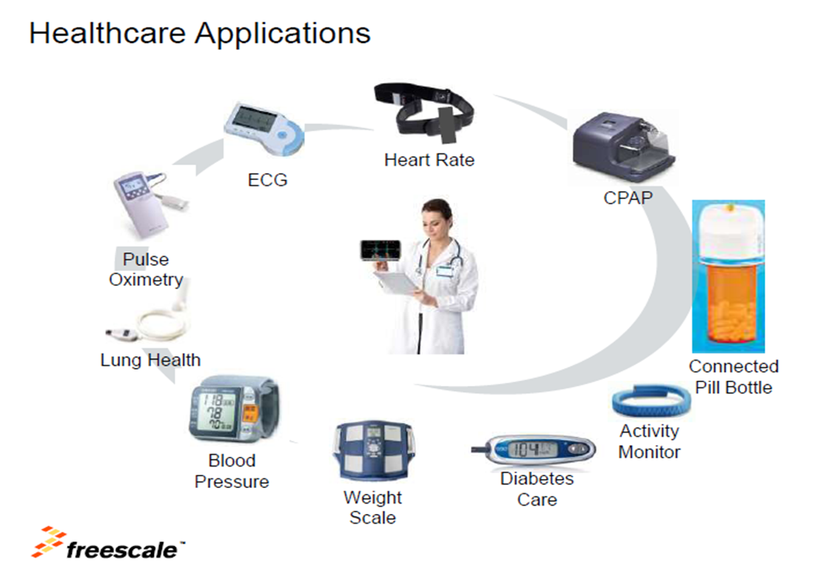

Slide 36
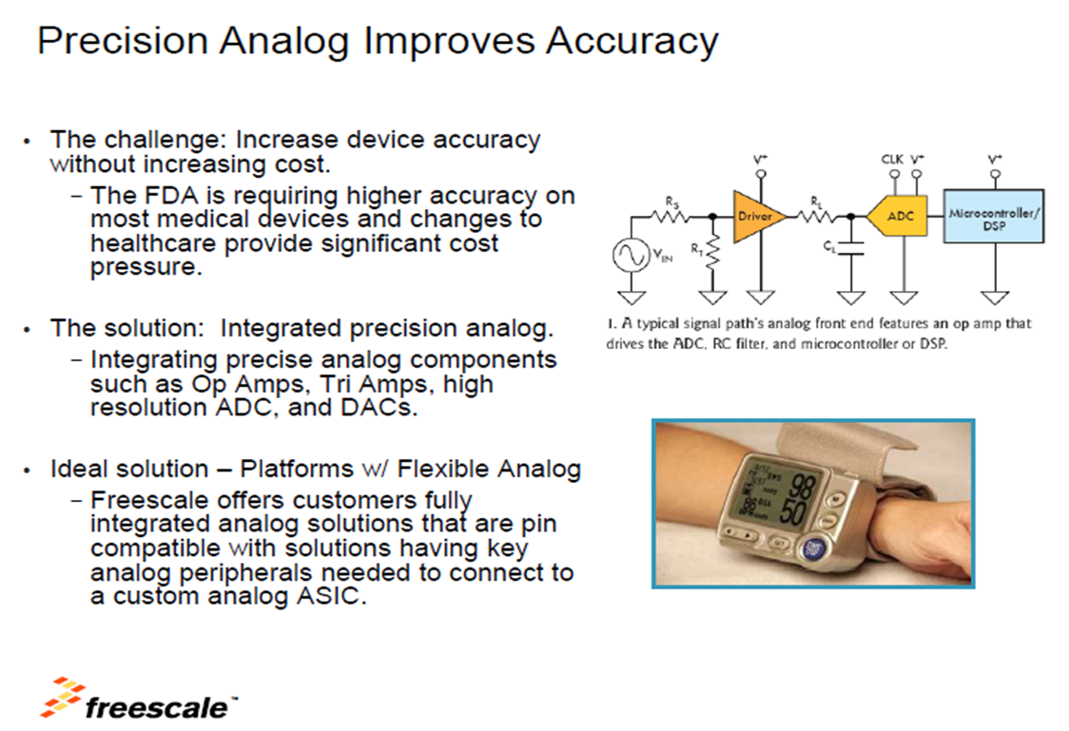

Slide 37
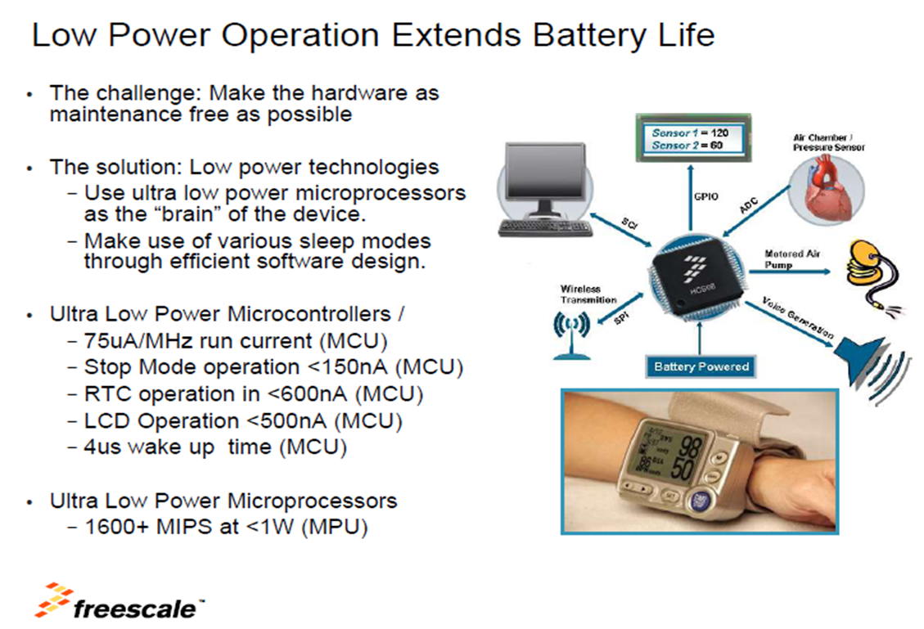

Slide 38
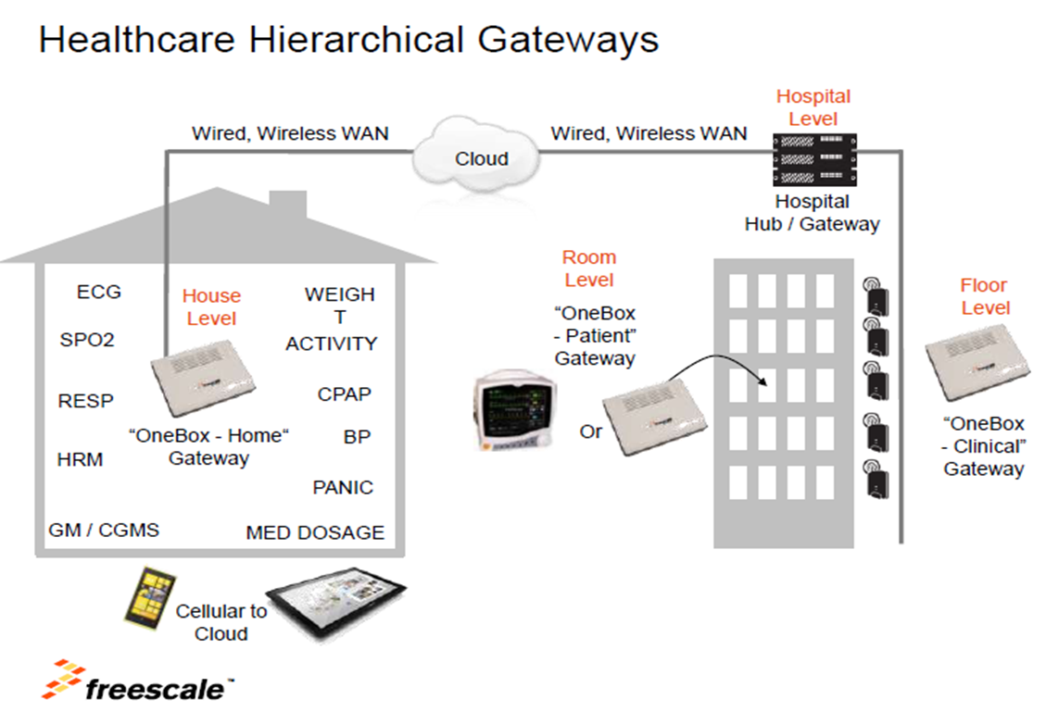

Slide 39
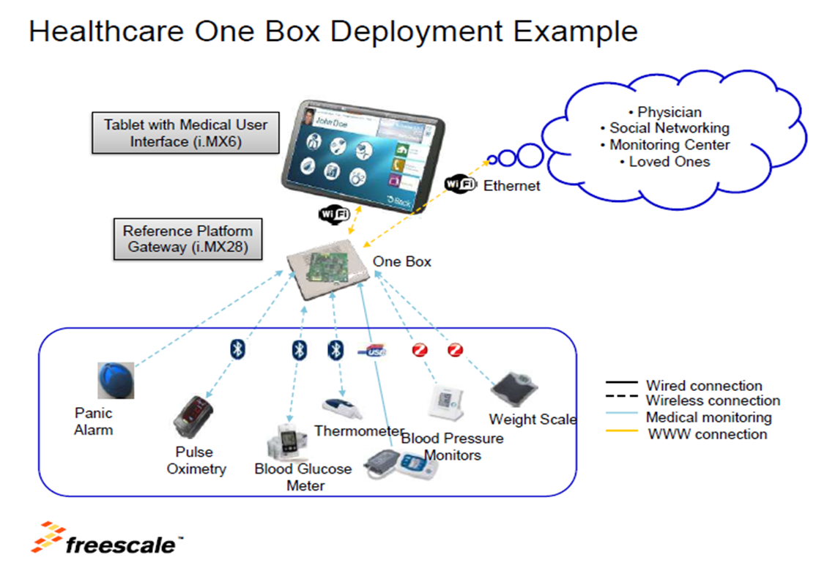

Slide 40
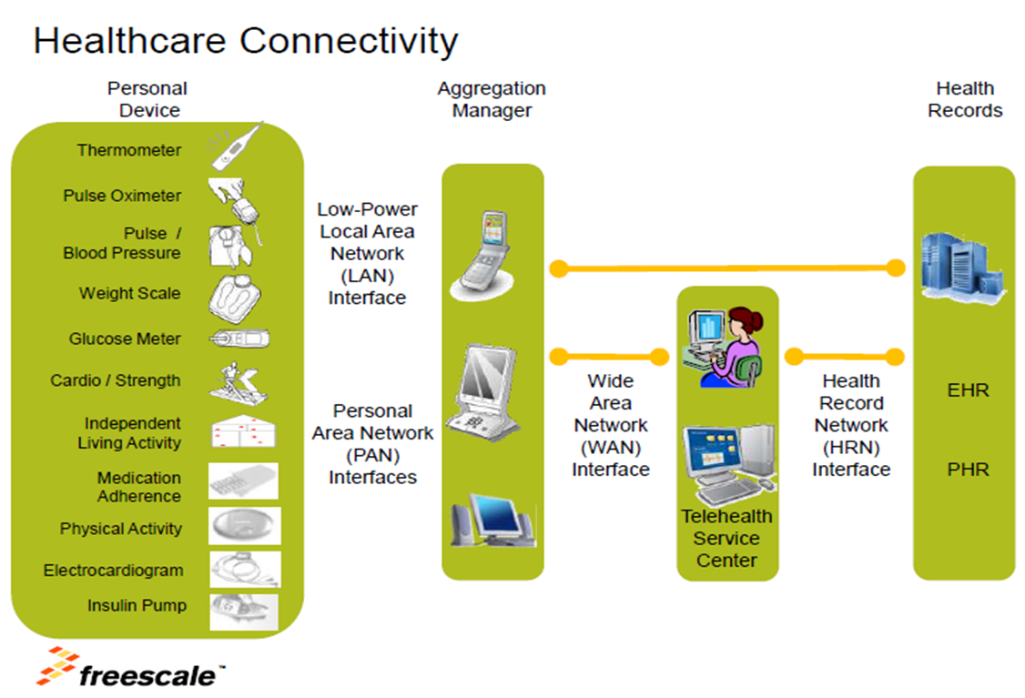

Slide 41
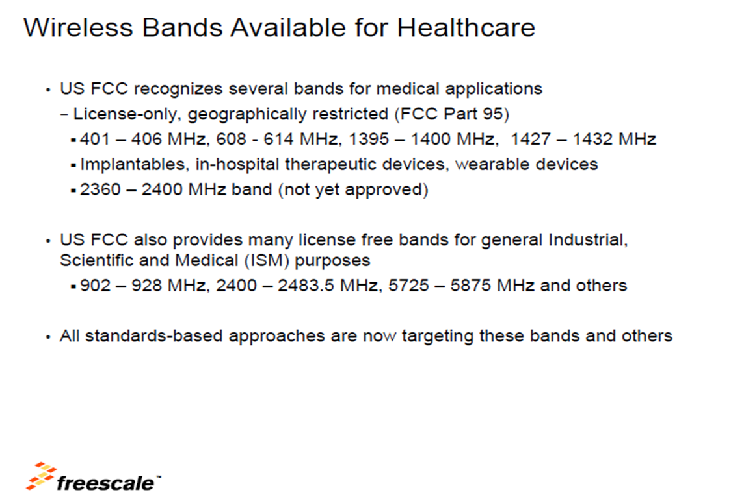

Slide 42
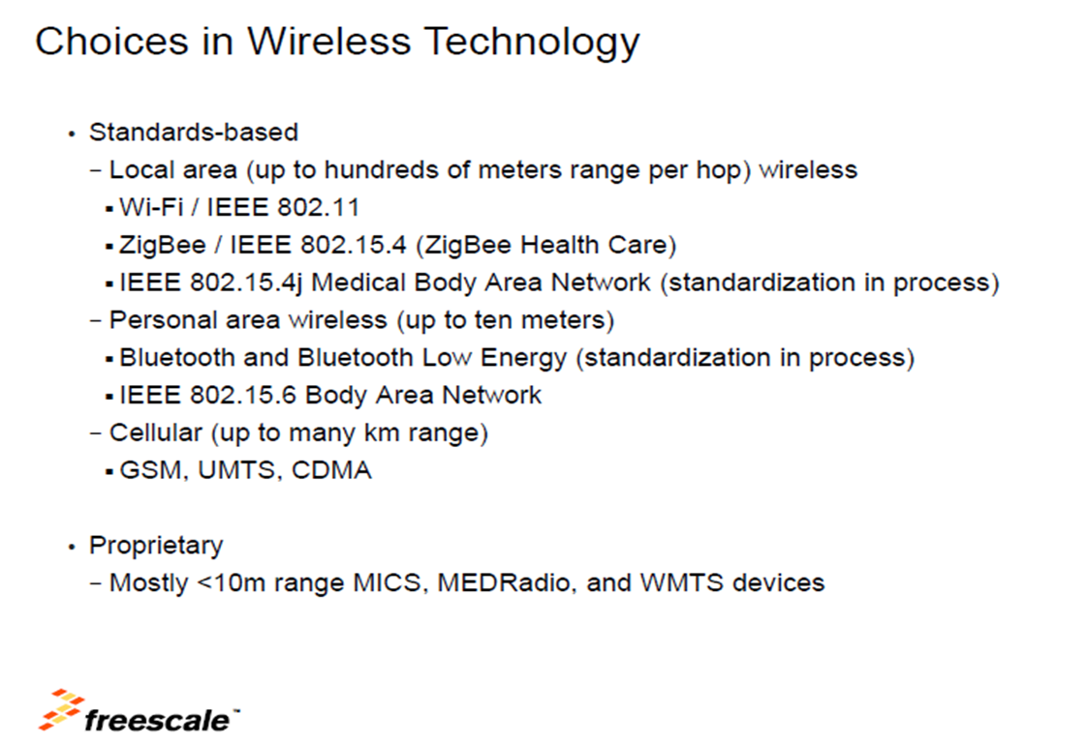

Slide 43
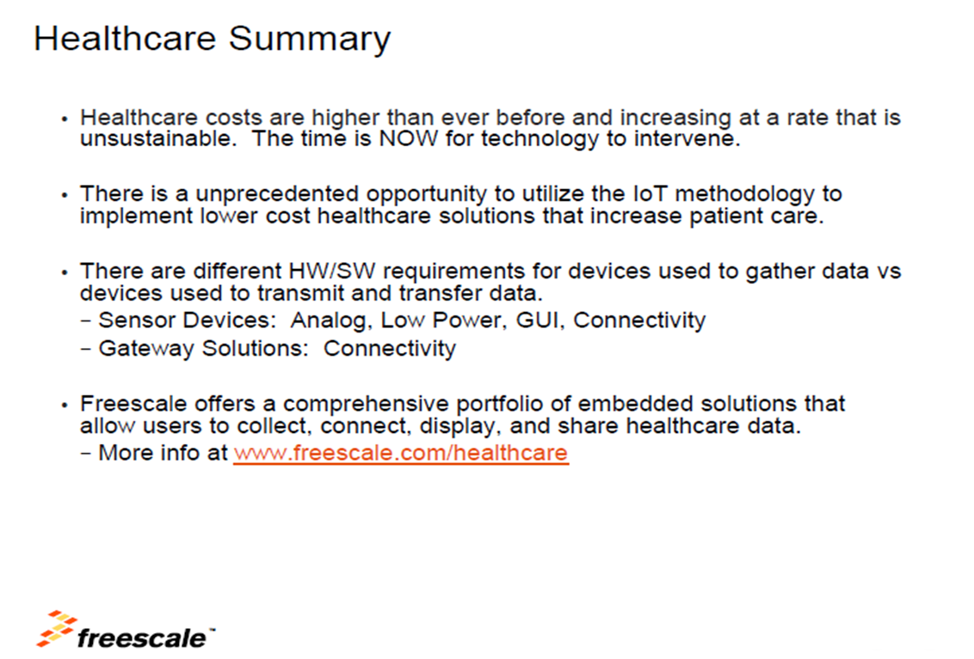

Slide 44
A List of Technologies Used for Medical Devices
General
• WLAN- 802.11 a/b/g/n
• Bluetooth- 802.15.1, Low Energy
• ZigBee - 802.15.4
• RFID / NFC
• Cellular- HSPA, HPSA+, LTE
• Mobile WiMAX- 802.16e
Medical
• Inductive coupling implants
• Medical-device radio communication service
• Medical micropower networks
• Medical body area networks (MBANs)
• Wireless medical telemetry (WMTS)
RF
• Coverage range or sensitivity
• Radio spectrum/frequency
• Data rate
• Interoperability
• Power

Slide 45
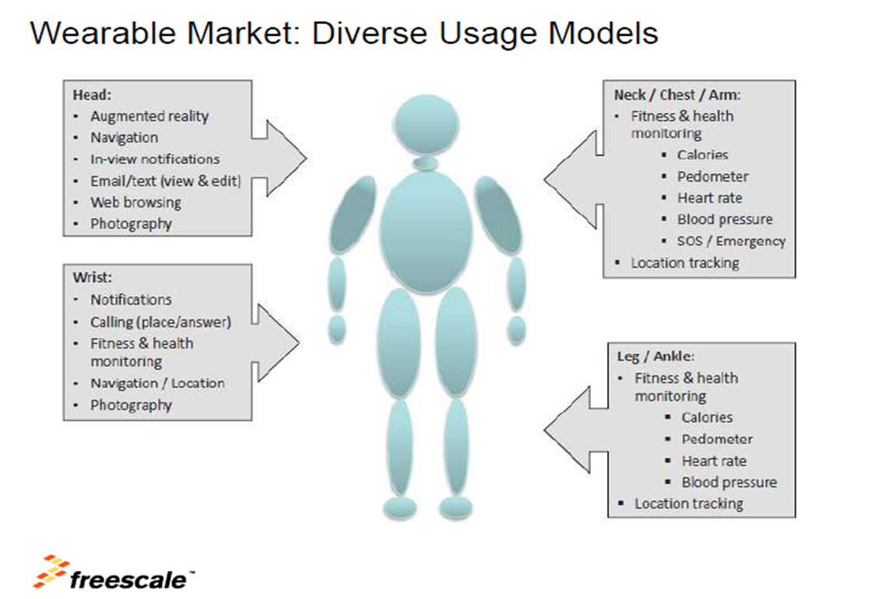

Slide 46
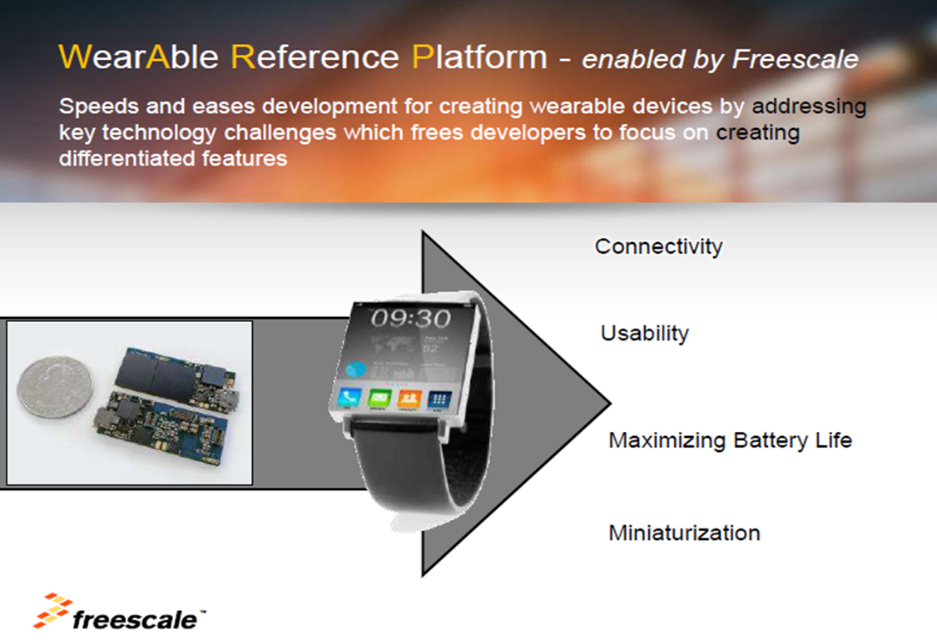

Slide 47
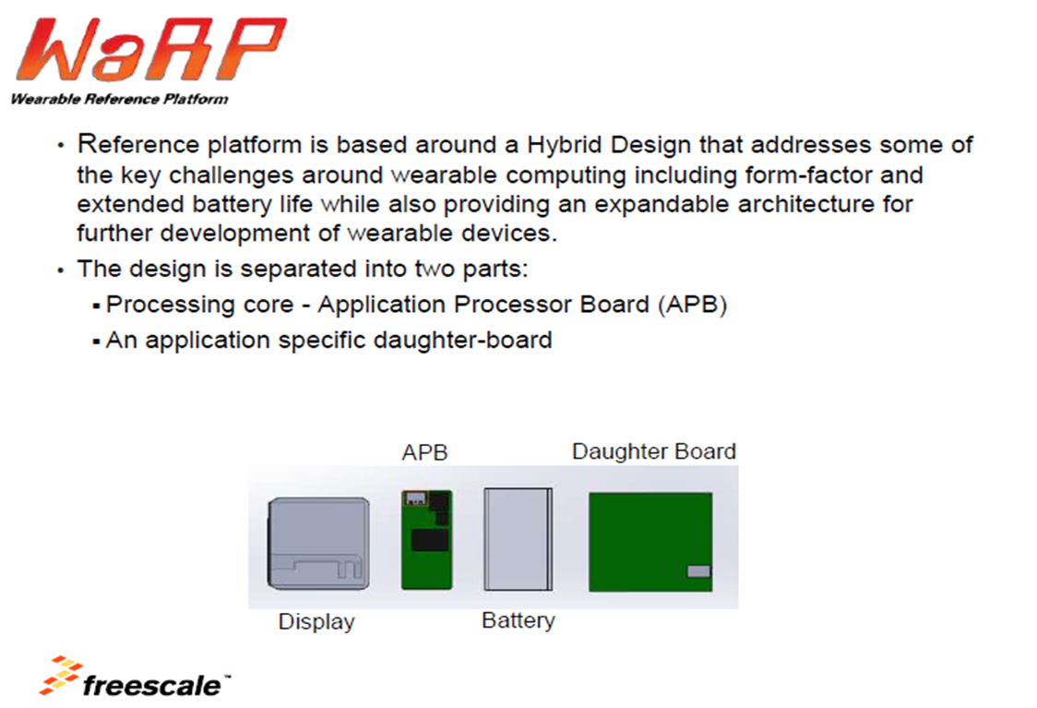

Slide 48
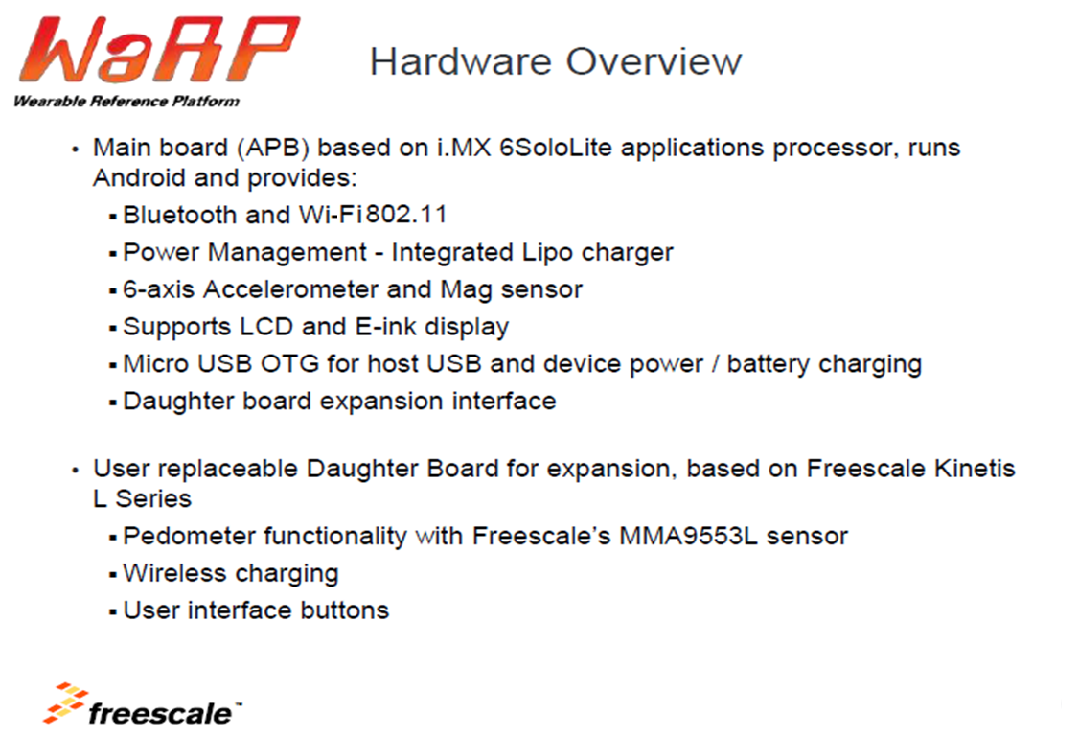

Slide 49
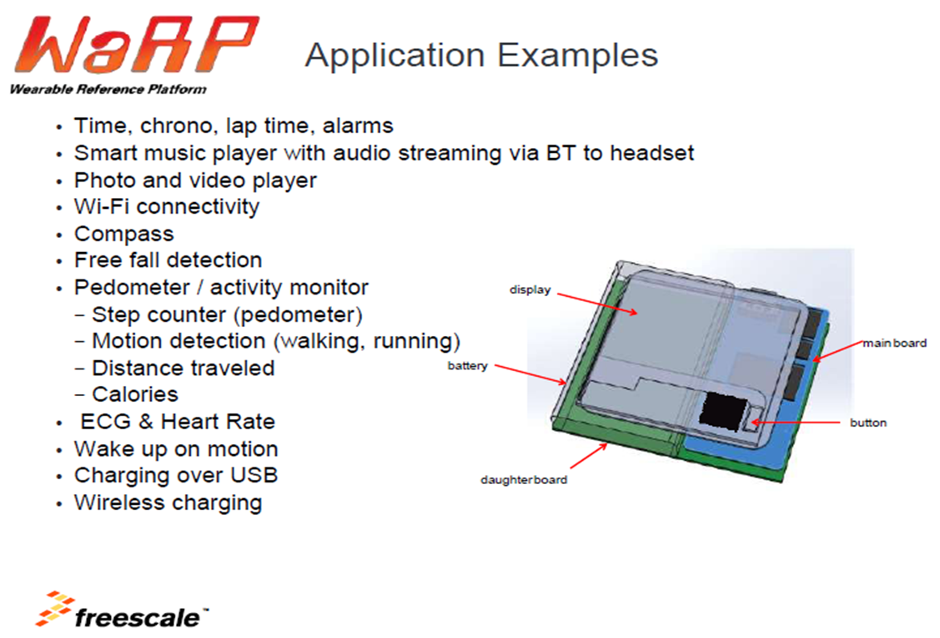

Slide 50
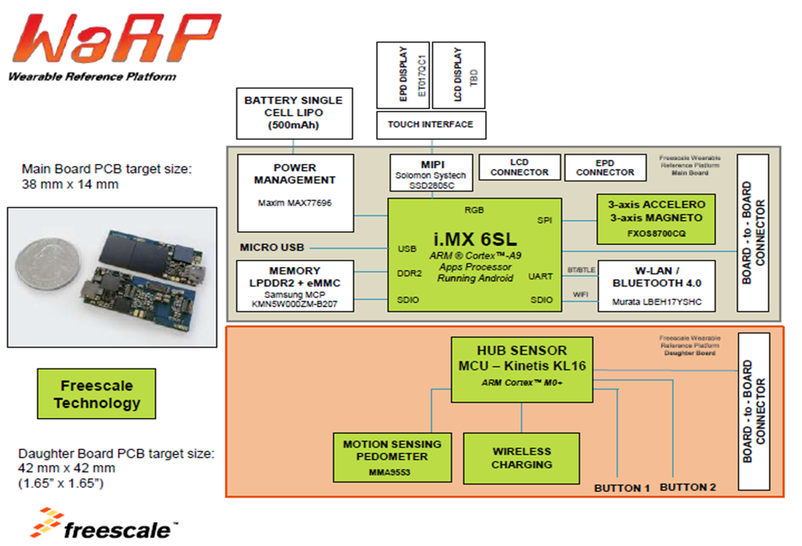

Slide 51
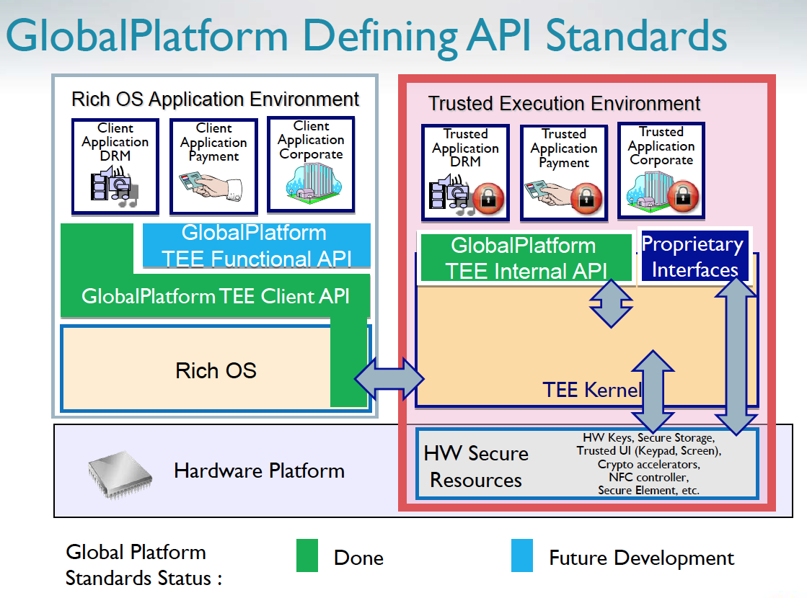

Slide 52
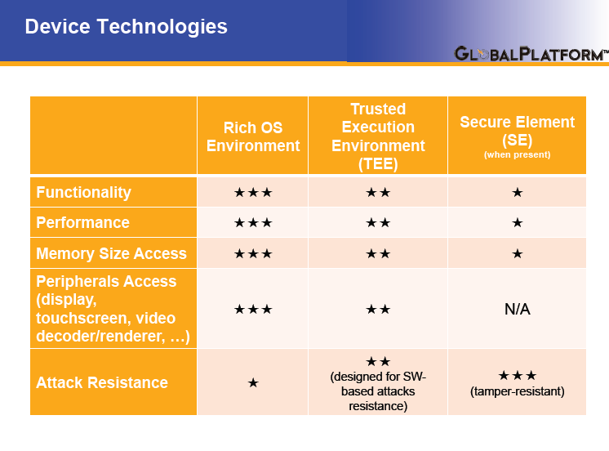

Slide 53


Slide 54


Slide 55


Slide 56


Slide 57


Slide 58


Slide 59


Slide 60

HIGH ASSURANCE EMBEDDED CRYPTOGRAPHIC TOOLKIT(HA-ECT)

Slide 61

Evolution of connected computing

Slide 62


Slide 63


Slide 64
IoT Protocols
MQTT: a protocol for collecting device data and communicating it to servers (D2S)
XMPP: a protocol best for connecting devices to people, a special case of the D2S pattern, since people are connected to the servers
DDS: a fast bus for integrating intelligent machines (D2D)
AMQP: a queuing system designed to connect servers to each other (S2S)

Slide 65

MQTT: the Message Queue Telemetry Transport

Slide 66


Slide 68

XMPP: the Extensible Messaging and Presence Protocol

Slide 69


Slide 70

DDS: Data Distribution Service

Slide 71


Slide 72


Slide 73

AMQP: the Advanced Message Queuing Protocol

Slide 74


Slide 75


Slide 76


Slide 77


Slide 78


Slide 79


Slide 80


Slide 81


Slide 82


Slide 83


Slide 84


Slide 85


Slide 86


Slide 87


Slide 88


Slide 89


Slide 90


Slide 91


Slide 92


Slide 93


Slide 94


Slide 95


Slide 96


Slide 97


Slide 98


Slide 99


Slide 100


Slide 101


Slide 102


Slide 103


Slide 104


Slide 105


Slide 106


Slide 107


Slide 108


Slide 109


Slide 110


Slide 111


Slide 112


Slide 113


Slide 114


Slide 115


Slide 116


Slide 117


Slide 118


Slide 119


Slide 120


Slide 121


Slide 122


Slide 123


Slide 124


Slide 125


Slide 126


Slide 127


Slide 128


Slide 129


Slide 130


Slide 131


Slide 132


Slide 133


Slide 134


Slide 135


Slide 136


Slide 137


Slide 138


Slide 139


Slide 140


Slide 141


Slide 142


Slide 143


Slide 144


Slide 145


Slide 146


Slide 147


Slide 148


Slide 149


Slide 150


Slide 151


Slide 152


Slide 153


Slide 154


Slide 155


Slide 156


Slide 157


Slide 158


Slide 159


Slide 160


Slide 161


Slide 162


Slide 163


Slide 164


Slide 165


Slide 166


Slide 167


Slide 168


Slide 169


Slide 170


Slide 171


Slide 172


Slide 173


Slide 174


Slide 175


Slide 176


Slide 177


Slide 178


Slide 179


Slide 180


Slide 181


Slide 182


Slide 183


Slide 184


Slide 185


Slide 186


Slide 187

Key features of the JenNet-IP networking software include:
Highly robust, easily scalable, self-healing tree network proven at over 500 nodes
Proven in a variety of residential and industrial applications, including asset management, lighting, solar and building control
IP-based networking to enable the Internet of Things
Gateway or non-gateway options for connection to the Internet or stand-alone operation
Easy-to-use, elegant and extensible SNAP object-oriented API
Highly secure: 128-bit AES encryption with secure authentication and device joining
Future-proof for device applications and network upgrades with Over-Network Download
Low memory footprint under 128KB
Low cost of ownership: small memory footprint, low development complexity, royalty-free
JenNet-IP is an enhanced 6LoWPAN network layer specifically targeting ultra-low-power networking based on IEEE 802.15.4 for both residential and industrial applications

Slide 188

NFC-Connected Tag Architecture

Slide 189

Home Climate Control System with NFC Commissioning

Slide 190

The Network Key Exchange Process

Slide 191


Slide 192


Slide 193


Slide 194


Slide 195


Slide 196


Slide 197


Slide 198


Slide 199


Slide 200


Slide 201


Slide 202


Slide 203


Slide 204


Slide 205


Slide 206


Slide 207


Slide 208


Slide 209


Slide 210


Slide 211

Wind River Intelligent Device Platform -- Architecture

Slide 212

Wind River Intelligent Device Platform -- Connectivity

Slide 213

Wind River Intelligent Device Platform -- Management

Slide 214

Wind River Intelligent Device Platform -- Security

Slide 215

Wind River Intelligent Device Platform -- Application Programming Interface

Slide 216

The Wind River Intelligent Development Platform (IDP) with a Trusted Platform Module (TPM)
For additional security, Wind River IDP also provides customizable secure remote management that:
Ensures end device integrity via secure boot
Provides encrypted communication between device and cloud-based management console
Limits exposure of untrusted applications through device resource management

Slide 217

The Evolution of VxWorks RTOS

Slide 218

The Virtualization Profile for VxWorks 7

Slide 219

VxWorks 7 Portfolio

Slide 220

The Wind River Carrier Grade Communications Server Architecture

Slide 221


Slide 222

McAfee DeepSAFE Technology

Slide 223

McAfee Deep Defender

Slide 224

McAfee DeepSAFE Technology

Slide 225


Slide 226


Slide 227


Slide 228


Slide 229


Slide 230


Slide 231


Slide 232


Slide 233


Slide 234


Slide 235


Slide 236


Slide 237


Slide 238


Slide 239


Slide 240


Slide 241

TrustZone Hardware Architecture

Slide 242

TrustZone Software Architecture

Slide 243

TrustZone Basic System Architecture

Slide 244

TrustZone Advanced System Architecture

Slide 245

TrustZone System IP Components

Slide 246


Slide 247

Android and RTOS together: The dynamic duo for today's medical devices

